Slide 1
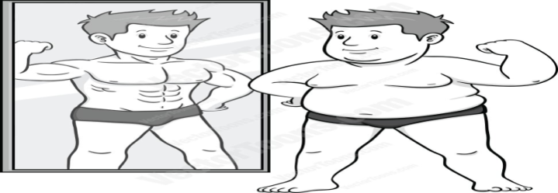
REFLECTION
Consider a ray of light being shone onto a mirror. This ray bounces off the mirror. This is called reflection.
To name the different angles, scientists imagine a perpendicular line (at 90°) at the point where the light hits the mirror. They call this line the normal.
The incoming light is called the incident ray.
The outgoing light is the reflected ray.
The angle between the incident ray and the normal is called the angle of incidence.
The angle between the reflected ray and the normal is called the angle of reflection.
The angle of incidence equals the angle of reflection.

Slide 2
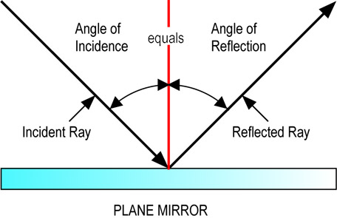
REFLECTION of a LIGHT RAY

Slide 3
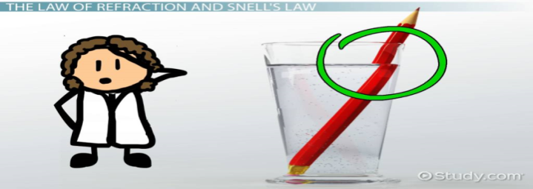
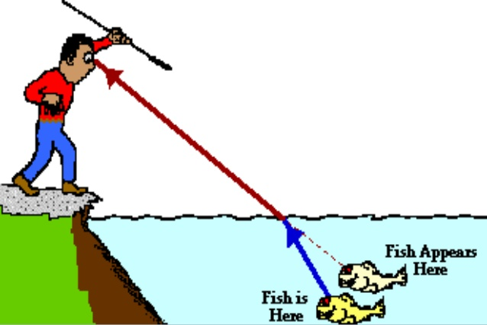
REFRACTION
Consider a ray of light being shone at an angle onto a rectangular block (prism) made of plastic.
Plastic is thicker than air, so the light going through it slows down. That is why it bends. This is called refraction.
The incoming light is called the incident ray.
The bent light at that surface is called the refracted ray.
The angle between the incident ray and the normal is called the angle of incidence.
The angle between the refracted ray and the normal is called its angle of refraction.
Light going from air into plastic bends TOWARDS normal.
Light going from plastic into air bends AWAY FROM normal.

Slide 4
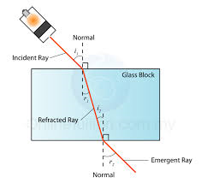
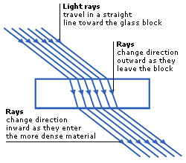
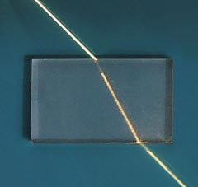
REFRACTION of a LIGHT RAY

